Slide 1
How did ideas about religion and government influence colonial life?
8.11 Describe the significance of and the leaders of the First Great Awakening, and the growth in religious toleration and free exercise of religion.

Slide 2
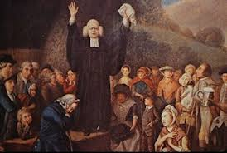
What do you see?
Write 3-5 sentences describing what you see/think is happening in this picture.

Slide 3
Read page 121-122 in your text.
Your purpose in reading is to determine what the Great Awakening was, who were the important people and why did it happen.
Take notes so that you can answer those questions.

Slide 4
Before the Great Awakening
Before the 1730s, most colonies had two established religions.
Congregationalism was the largest religion in New England (Puritans and other dissidents who broke away from the Church of England).
Anglicanism was the largest religion in New York and the Southern colonies (same as the Church of England).

Slide 5
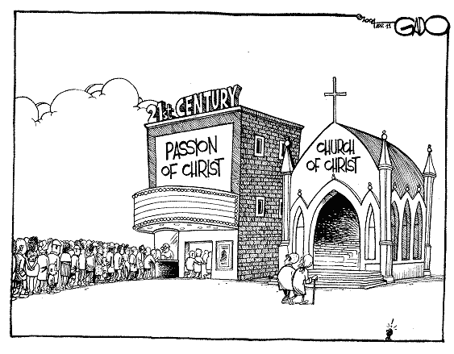
The First Great Awakening
As the colonies became more successful, people felt as if they had lost their faith
Was a large motivation for founding the colonies
Sparked a religious revival known as the Great Awakening
A revival of religious feeling in the American colonies during the 1730’s and 40’s

Slide 6
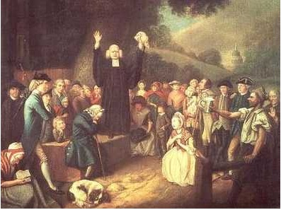
What was the Great Awakening?
Religious revival movement
Evangelicism – “new birth” considered the ultimate religious experience
Followers accepted that they were sinners and asked for salvation
George Whitefield preaching

Slide 7
Old Lights vs. New Lights
Churches that grew as a result of the Great Awakening: Presbyterianism, Methodism, Baptism (New Lights)
Great Awakening challenged authority and hierarchy of established churches (Old Lights: Congregationalists and Anglicans)
Great Awakening said that anybody could be converted and born again. You didn’t need traditional church leadership to decide whether or not you belonged.

Slide 8
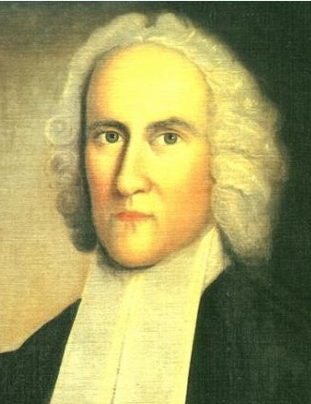
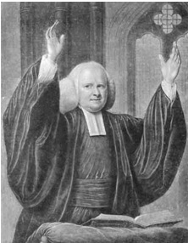
Leaders of the Great Awakening
Jonathan Edwards
George Whitefield

Slide 9
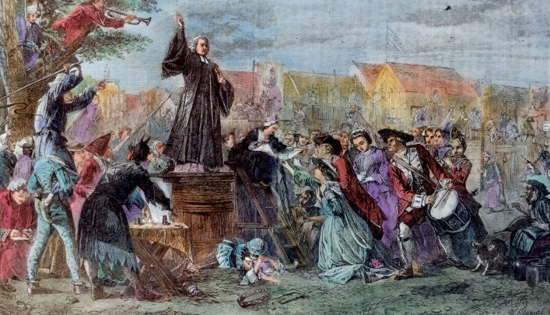
Weakened the status of “old-fashioned” churches
Encouraged people to use their own judgment and help others
Introduced the ideas of equality and the right to challenge authority
People began to feel confident in their own thoughts and decisions
Helped contribute to colonists desire for independence and the American Revolution

Slide 10
Discuss the following with your table group:
Why might the Great Awakening have unsettled many prominent church leaders of the time?

Slide 12
https://www.youtube.com/watch?v=5vKGU3aEGss
8:43

Slide 13
First Great Awakening
First Great Awakening-
A revival of religious feeling in the American colonies during the 1730’s and 40’s
Introduced ideas of equality and challenging authority
Weakened “old-fashioned” churches
Contributed to desire for colonial independence
Encouraged people to use their own judgment

Slide 14
Take a Stand
People must obey their rulers.

Slide 15
John Locke
Read p. 122-123
Examine the chart at the top of the page.
Think/Ink/Share-answer the questions about the chart.

Slide 16
Baron de Montesquieu
Finish 123
How did Locke and Montesquieu impact the development of our current government?

Slide 17
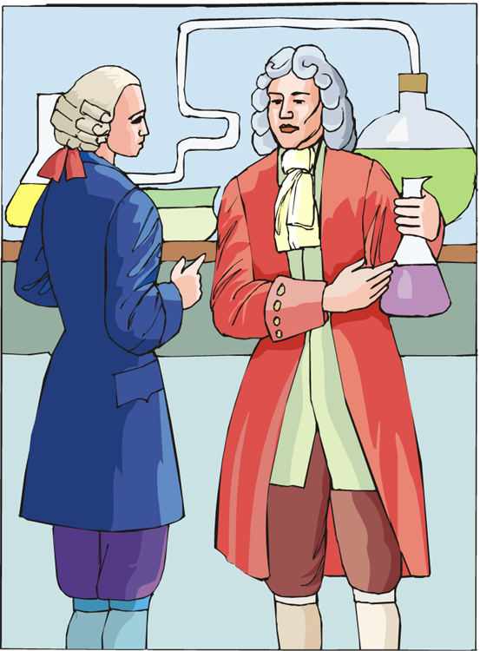
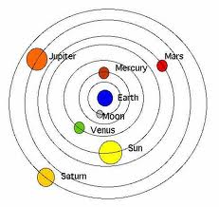
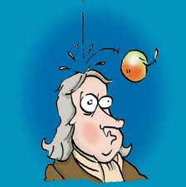
The Enlightenment
Along with religious change, the Enlightenment introduced changes to scientific understanding
An intellectual movement that stressed:
Power of reason
The importance of science for finding the paths to knowledge
Colonists were now open to new scientific ideas

Slide 18
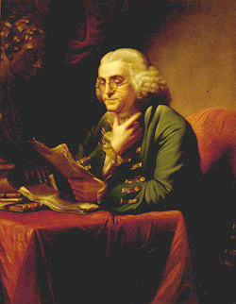
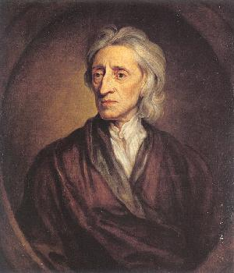
The Enlightenment
Ben Franklin = “Mr. Enlightenment”
Worked constantly on inventions and on improving society
Libraries, fire company, Franklin stove, lightning rod, bifocals, University of Pennsylvania, etc.
John Locke = Natural Rights
Did not believe kings had a God-given right to rule
People automatically have certain rights (life, liberty, property)
To protect those rights, people created governments
Government exists to protect the people
Led colonists to wonder whether the British government protected their rights and freedoms

Slide 19
Enlightenment
Enlightenment- introduced changes to scientific understanding
Government exists to protect people
John Locke = Natural Rights
Led colonists to wonder whether they were being protected
People automatically have certain rights (life, liberty, property)

