Slide 1
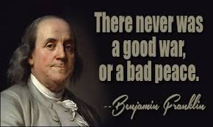
How did Benjamin Franklin contribute to American society?
8.17 Evaluate the contributions of Benjamin Franklin to American society in the areas of science, writing and literature, and politics, including analysis of excerpts from Poor Richard's Almanac, The Autobiography of Benjamin Franklin, the Albany Plan of Union and the Join or Die Cartoon.

Slide 2
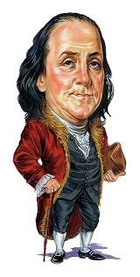
Whadya know?

Slide 3
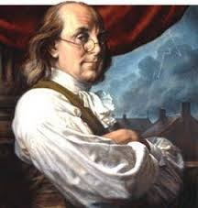
Early Life | Inventions | Political Life

Slide 4
Read about Ben Franklin on page 120. Fill in graphic organizer.
Early Life | Inventions | Political Life

Slide 5
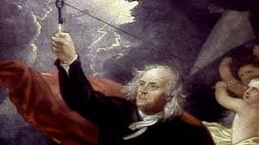
Read about Ben Franklin in his biography. Fill in graphic organizer.
Early Life | Inventions | Political Life

Slide 6
Watch Tim and Moby. Fill in graphic organizer.
http://www.brainpop.com/science/energy/benjaminfranklin/
Early Life | Inventions | Political Life

Slide 7
Norths tell Souths about the inventions that Ben created and how they changed life in America (at least 3 things)
Souths tell Norths about Franklin’s political life and how it changed life in America (at least 3 things.)

Slide 8
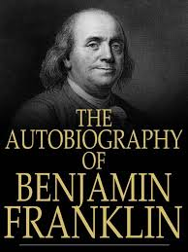
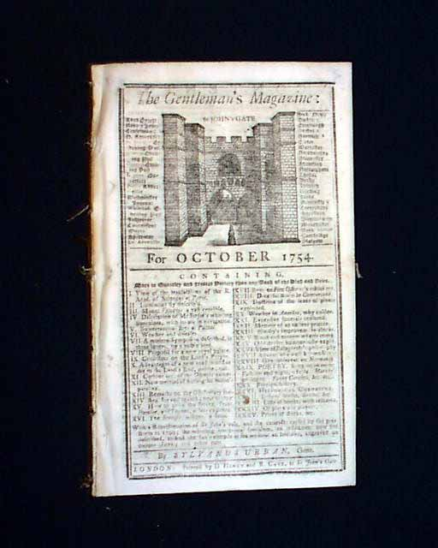
Ben’s Writings
1 p.124-125 Analyze Literature
2 p.726
Analysis worksheet
3 handout
Analysis worksheet

Slide 9
Dear Teacher Letter (to turn in today)
Write me a letter (My Dear Mrs. Fabulousness ☺)
Explain three things Franklin said in the document that you think is important.
Include evidence that supports why it was written.

Slide 10
Poor Richard’s Almanack
1. At the working man's house, hunger looks in but dares not enter.
2. Industry pays debts while despair increases them.
3. The noblest question in the world is: What good may I do in it?
4. Hear no ill of a friend, nor speak any of an enemy.
5. Many a man thinks he is buying pleasure when he is really selling himself a slave to it.
6. Doing an injury puts you below your enemy. Revenging one makes you just even. Forgiving it sets you above.
7. There’s none deceived but one who trusts.
8. Search other for their virtues, yourself for your vices.

Slide 11
Poor Richard’s Almanack
9. Content makes a poor person rich; discontent makes a rich person poor.
10. The heart of a fool is in his mouth, but the mouth of a wise man is in his heart.
11. He that lives carnally, won't live eternally.
12. Do good to thy Friend to keep him, to thy enemy to gain him.
13. He that cannot obey, cannot command.
14. He does not possess Wealth, it possesses him.
15. Approve not of him who commends all you say.
16. If you do what you should not, you must hear what you would not.
17. Lend Money to an Enemy, and thou'lt gain him, to a Friend and thou'lt lose him

Slide 12
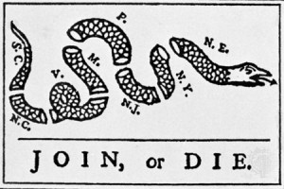
p.141

Slide 13
ACROSTIC
B
E
N
F
R
A
N
K
L
I
N

