Slide 1
How did location, geographic features, and religion influence the development of the New England colonies?
8.3 Explain the founding of the Plymouth Colony, including the Separatists, William Bradford, Mayflower, Mayflower Compact, and Squanto.
8.4 Analyze the reasons for the settlement of the Massachusetts Bay Colony and the events and the key figures of the colonies.
8.10 Locate and identify the first 13 colonies, and describe how their location and geographic features influenced their development.
8.12 Compare and contrast the day-to-day colonial life for men, women, and children in different regions and of different ethnicities.
8.13 Analyze the ideas that significantly impacted the development of colonial self-government by citing textual evidence and examining multiple perspectives

Slide 2
Vocabulary
Theocracy:
Persecute

Slide 3
Thomas Hooker
John Winthrop
Pilgrims
Non-separtists
Mayflower Compact
Squanto
Town meetings
Salem Witch Hunt
Roger Williams
Puritans
Mayflower
Theocracy
Separatists
Anne Hutchinson
William Bradford
Protestants

Slide 4
13 Colonies Flip Book
Label and color (the same color) your map with the New England colonies.

Slide 5
WUAH 08/19/14
What role did the Virginia Company play in the founding of Jamestown?
List 3 reasons people settled in the New World.
Why was the House of Burgesses important?

Slide 6
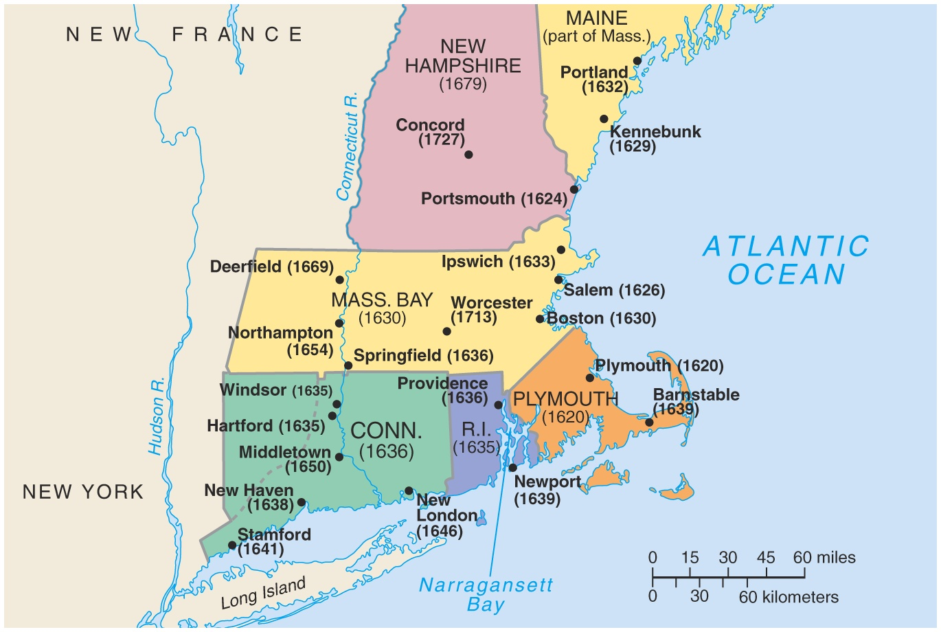
New England Colonies

Slide 7
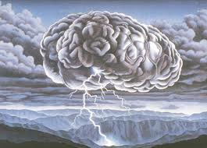
Why was farming not developed in the New England Colonies?
Read p. 71
How did the geography of the region effect the colonies/colonists?

Slide 8
Geography
Fill out the geography section of your flipbook.

Slide 9
Read p. 69-76
Fill out chart in flip book as you go

Slide 10
WUAH 08/20/14
Compare and Contrast the settling of Jamestown and Plymouth. (Include everything you know)
What is the difference between the Puritans and the Pilgrims?
What was noteworthy about the Mayflower Compact?

Slide 11
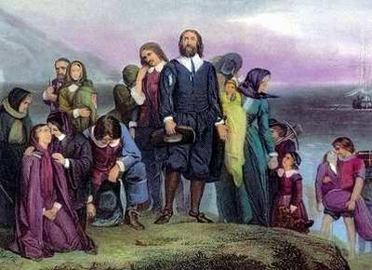
New England Settled For Religious Freedom !
Pilgrims: at Plymouth
Puritans : at Massachusetts Bay

Slide 12
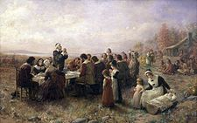
Pilgrims-William Bradford
Suffered persecution in England
Wanted religious freedom
Desired a better way of life in the New World
Wanted to break away or “separate” from the Anglican church and begin own churches-called Separatists

Slide 13
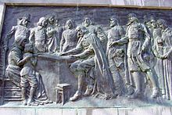
Believed in pre-destination
Sailed on the Mayflower
Wrote and signed the Mayflower Compact-agreeing to govern together
Mayflower Compact is one of the beginning steps toward representative government
Squanto provided the seeds for native plants

Slide 14
The Mayflower Compact November 11, 1620

Slide 15
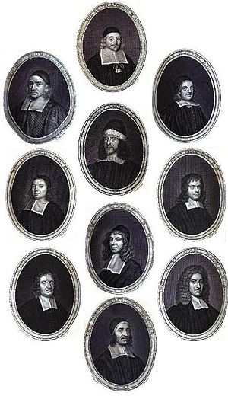
Puritans-John Winthrop
Suffered persecution in England
Wanted religious freedom
Desired a better way of life in the New World
Wanted to reform or “purify the Anglican Church
Strongly believed that sinners should be punished

Slide 16
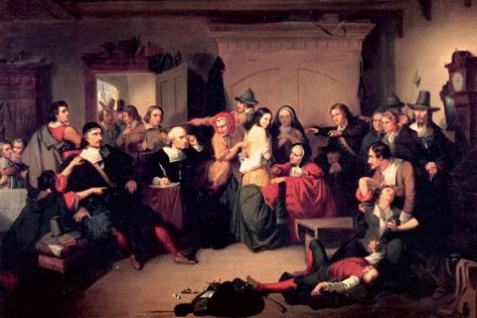
Puritans
Devout Bible believers
Bible guided all actions
Felt God would punish any wrongdoings
Extremely intolerant of any other religions or beliefs
Orchestrated Salem Witch Trials

Slide 17
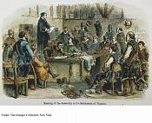
Dissenters ! ( people who disagreed with the Puritans)
Roger Williams
Started Rhode Island
* no forced church
* pay Indians for land
* separate church from the state

Slide 18
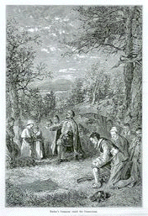
Thomas Hooker Founds Connecticut Colony
Opposed requiring
Church membership
in order to vote
So he and his church
members started Connecticut
They got permission
and wrote a constitution:
* The Fundamental Orders of Connecticut

Slide 19
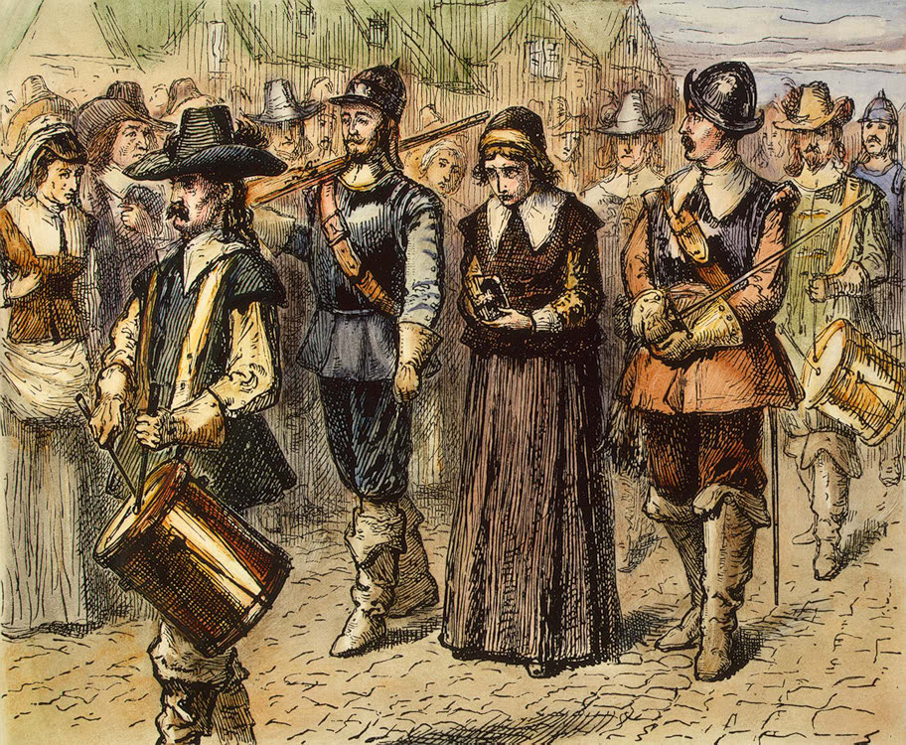
Anne Hutchinson
* lead Bible discussions at home
Believed ministers, churches, and the Bible weren’t required for worship
Put on trial and banished for her CRIME
Helped give us religious freedom !

Slide 20
Puritans vs. Pilgrims
Create a comparison chart for the two.

Slide 21
p.107-112
 | Men | Women | Children | Free African Americans
New England
Middle
Southern
Do this row only.

Slide 22
P712-715
Mayflower Compact 1620
Charter of Massachusetts Bay Colony 1629
Fundamental Orders of Connecticut 1639
New England Articles of Confederation 1643

Slide 23
Write an essay discussing how the ideas presented in the documents impacted the development of colonial self- government by citing textual evidence.

Slide 24
Cartoon
Create a cartoon about the New England Colonies
It must answer the EQ and discuss how New England was formed

Slide 25
Map
On your big map, label all the New England colonies and include their natural resources

