Slide 1
WUAH 08/22/14
1. What made the settlement of Rhode Island important?
2. List the four colonies of New England. Why are there 4 and not 5?
3. Why did the Salem Witch Trials happen in a puritan colony?

Slide 2
The Middle Colonies
New Netherlands (New York), New Jersey, Pennsylvania, Delaware

Slide 3
EQ: How did geographic location and culture influence the development of the middle colonies?
8.5 Describe the settlement of the New Netherlands and the subsequent possession of the colony by the English, including: Dutch influences, Peter Stuyvesent, Patroon System, Renaming to New York, Diverse Population
8.6 Analyze the founding of Pennsylvania as a haven for Quakers and the tolerance that drew many different groups to the colony, including: William Penn, Philadelphia, Role of women, Relationship with Indians
8.10 Locate and identify the first 13 colonies, and describe how their location and geographic features influenced their development.
8.12 Compare and contrast the day-to-day colonial life for men, women, and children in different regions and of different ethnicities, including the system of indentured servitude, as well as their connection to the land.

Slide 4
Activator: Map Quest
Look over the map of the Middle Colonies
What major rivers do you notice in these colonies?
How do you think these rivers play a role in the economies of the Middle Colonies?

Slide 5
Geography of the Middle Colonies
Location | New York, Pennsylvania, New Jersey, and Delaware (in order from largest to smallest) were the Middle Colonies.
Landforms | Much of the Middle Colonies is lowlands. The Hudson and Delaware rivers are important waterways in the region. The soil is fertile and well-suited for crops like wheat, fruits, and vegetables.
Climate | The climate is warmer, with a longer growing season, than the New England climate.

Slide 6
Vocabulary: KWL
Look over your Vocabulary Chart
Complete the first section of your chart for what you already know about the following vocabulary words:
  Patroon System
  Tolerance
  Quaker
  Proprietary Colony
  Royal Colony

Slide 7
WUAH 08/25/14(you may not use your notes or book)
Why were the middle colonies founded?
What events caused slavery to occur in colonial America?
Compare the geography of the New England colonies to the Middle colonies.

Slide 8
How did the diverse Middle Colonies develop and thrive?
Colonists settled in the Middle Colonies for freedom of religion or to profit from trade, farming, or other occupations.
Factors such as fertile soil, manufacturing, and social equality promoted the colonies’ prosperity.

Slide 9
Activity 1
Read p78-79.
Add information to your flipbooks based on your assigned reading.
North will teach South about the New Netherlands
South will teach North about Pennsylvania
Be sure to pick out the most important information!

Slide 10
The New Netherlands
Henry Hudson was hired by the Dutch East India Trade Company to find a northeast passage to India in 1609.
Instead, Hudson discovered some land in North America that he claimed for his Dutch employers.
The Dutch established this land as The New Netherlands, and it was in their control until 1664.

Slide 11
The Patroon System
Beginning in 1629, The Dutch East India Company developed a new charter allowing rich Dutchmen to purchase lands from the Native Americans.
This system of purchasing and running the land became known as the Patroon System, which is very similar to the feudal system of the middle ages. Wealthy land owners controlled the land and the people who worked the land.

Slide 12
England
Holland
England and Holland had tense relations because:
New Netherland separated England’s northern colonies from its more southern colonies.
New Netherland traded with English colonies, which violated Britain’s mercantile laws.

Slide 13
In 1664, England’s King Charles II told his brother James, Duke of York, that he could have New Netherland if he conquered it.
___________________
With the help of a few warships, James did just that.
New Netherland
New York
James renamed the colony New York and its capital New York City, and it became a royal colony in 1685.

Slide 14
New York
In 1665, part of southern New York split off and formed a new colony, New Jersey.
At first, New Jersey was a proprietary colony, but in 1702, it received a new charter as a royal colony.
New Jersey

Slide 15
Assessment 2
Give one. Get one.
In your notebooks, write down at least 3 important things you’ve learned about the colony of New York
For 2 minutes, give one and get one with your peers. Explain to your peers why you chose that particular fact.

Slide 16
The Quakers emerged as a new religious group in England during the 1640s and 1650s.
Slavery
The Quakers believed:
People do not need ministers because everyone has a direct link with God.
All people are equal in God’s eyes; therefore, women are equal to men in spiritual matters, and slavery is wrong.

Slide 17
Quaker leader William Penn wanted to find a place where Quakers could live free of persecution.
He used his connections to get a charter from the king for a new colony in North America.
Pennsylvania charter
Penn arrived in the Pennsylvania colony in 1682 and established its capital, Philadelphia.

Slide 18
Penn considered his colony to be a “holy experiment” of people from different faiths living together in peace.
Home Countries of Pennsylvania Settlers:
England
Scotland
Wales
Ireland
Germany
Holland
Switzerland
In 1682, Penn wrote a document that granted Pennsylvania an elected assembly and provided for freedom of religion.

Slide 19
Pennsylvania Government
Pennsylvania's first constitution, the Frame of Government was drafted in April, 1682, with an upper house and lower house of legislature. The assembly approved the second Frame of Government in 1683.
In 1701, William Penn created a Charter of Privileges for the residents of his colony.
Penn envisioned a colony that permitted religious freedom, the participation of the governed, and other laws pertaining to property rights.
The Charter of Privileges recognized the authority of the King and Parliament over the colony, while creating a local government that would propose and execute laws.

Slide 20
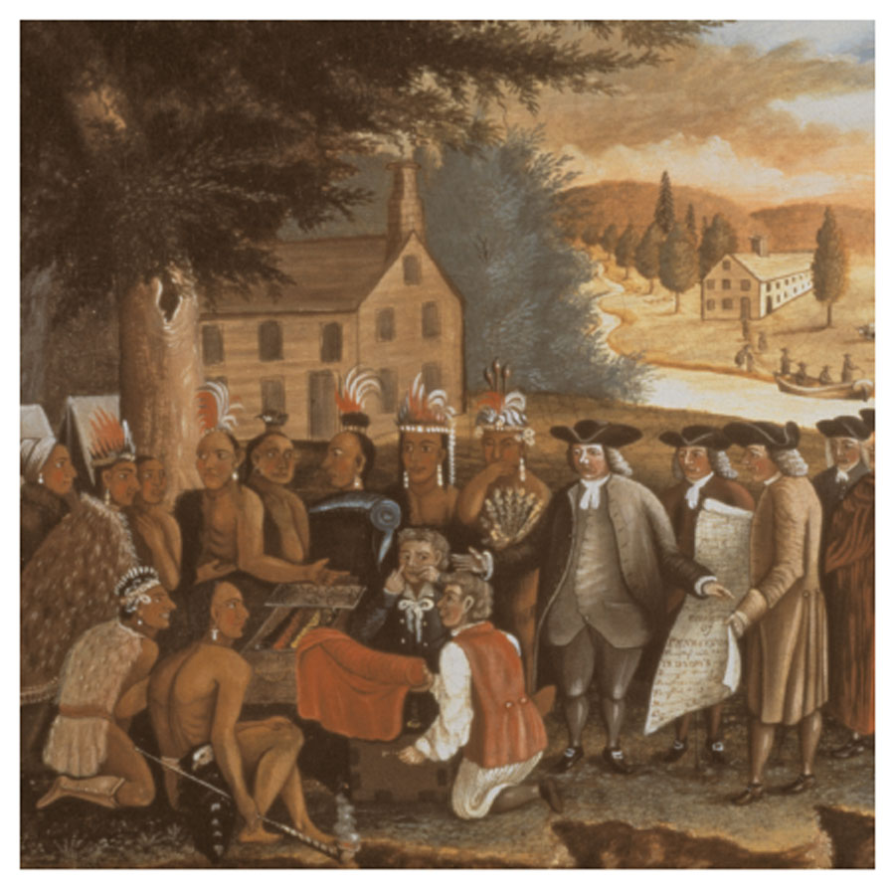
Penn tried to deal with Native Americans fairly; he did not allow colonists to settle on land until Native Americans sold it to them.
During Penn’s lifetime, relations between Native Americans and colonists were much better in Pennsylvania than they were in other colonies.

Slide 21
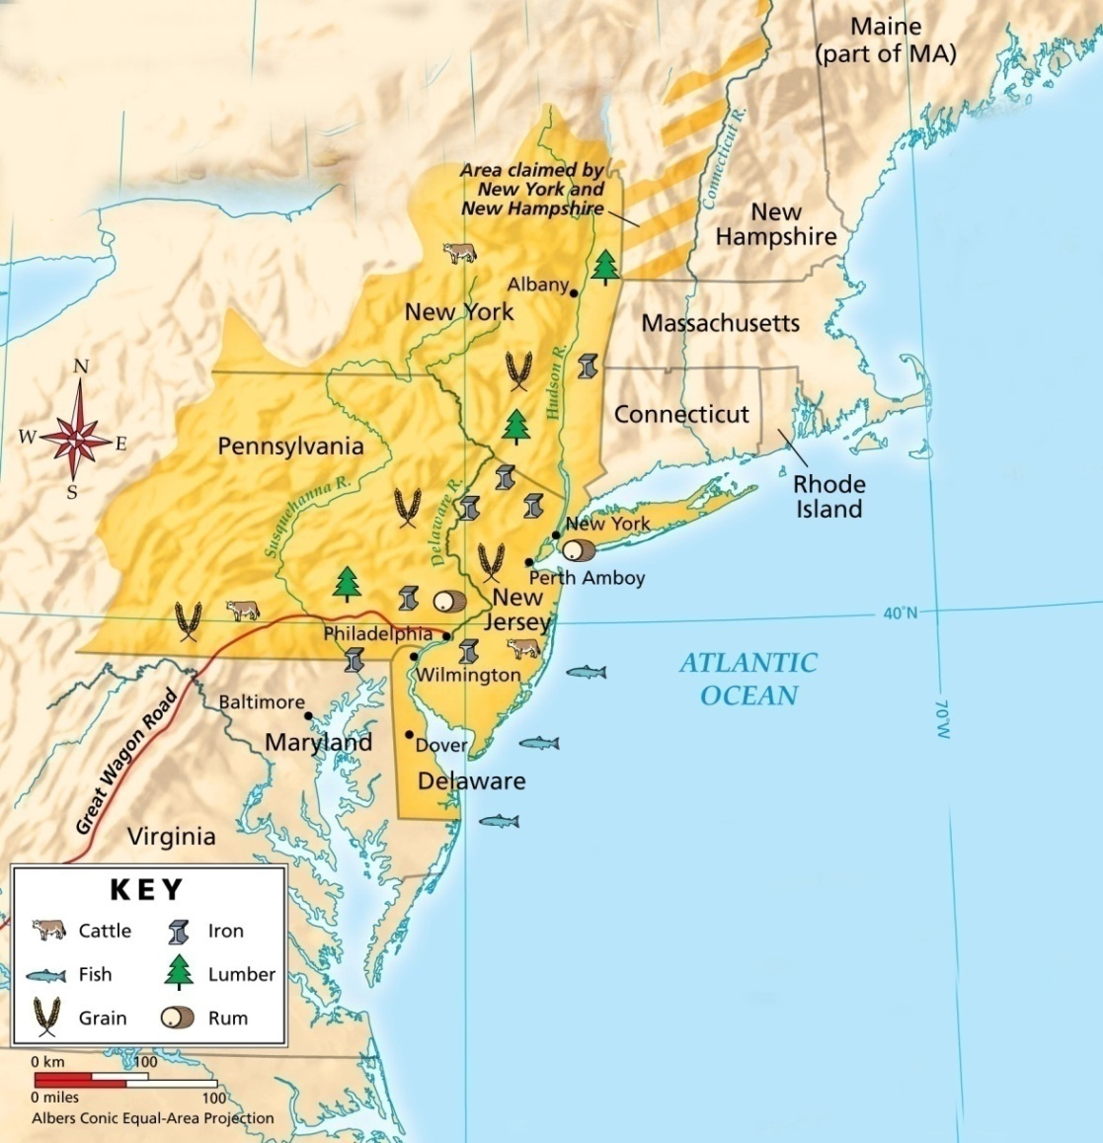
By the early 1700s, more than 20,000 colonists lived in Pennsylvania.
Its wheat farms were productive, and Pennsylvania was called America’s breadbasket.

Slide 22
Delaware
Where does Delaware fall in all of this?

Slide 23
Manufacturing was just beginning in the Middle Colonies during the 1700s.
Manufacturers produced iron, flour, and pepper.
Town artisans worked as weavers, masons, coopers (barrel-makers), and in many other trades.

Slide 24
By 1750, non-English immigrants had made the Middle Colonies the most diverse part of English North America.
Philadelphia and New York had become the largest cities and busiest ports in the colonies.
All of the colonies had thriving economies.

Slide 25
p.107-112
 | Men | Women | Children | Free African Americans
New England
Middle
Southern
Do this row only.

Slide 26
Assessment 3
R.A.F.T.
You are William Penn, and you are writing a letter to the King of England.
Summarize how things in the colony are going. How are the crops?
Explain why you think it’s important to establish tolerance in your colony, and describe rules you’ve put in place to ensure stability.

Slide 27
TOTD: 3-2-1
3 major differences between the New York and Pennsylvania colonies
2 important geographic features of the Middle Colonies
1 person and his contribution to the establishment of the middle colonies

Slide 28
Complete a one page written response in which you compare and contrast the development of New York and Pennsylvania using information from your flipbooks and your textbook (p 82-85 in your textbook at home).

