Slide 1
What were the reasons for French exploration?
8.8 Describe the location and reasons for French exploration and settlements in North America, including the Huguenots.

Slide 2
Vocabulary
Huguenots
Samuel de Champlain
Quebec
Jacques Marquette

Slide 3
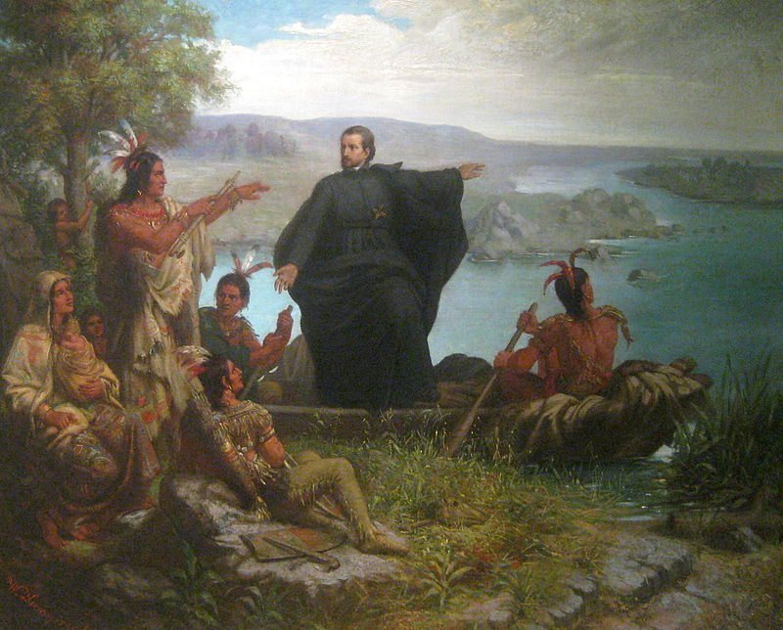
Take 2 minutes and write down what you see and what you think is happening.

Slide 4
French Exploration Article
Fill in Graphic Organizer as we read the article.

Slide 5
Map on p. 54
Answer the questions on p. 54
(c) What do you notice about the routes of the explorers?
http://phschool.com/atschool/ahon/mapmaster/mapms_mv_ch02_p0054.swf

Slide 6
Read p. 53-55 in the textbook and add notes to your graphic organizer.
Pair/share: Come up with 3 reasons the French colonists began to farm in large numbers.

Slide 7
What impact did the establishment of French and Dutch colonies in North America have on Native Americans?
In the early 1600s, England, France, and the Netherlands sent explorers to North America and staked claims to land there.
Their activities had grave consequences for the Native Americans who lived in North America.

Slide 8
In 1603, Samuel de Champlain made the first of 11 voyages to explore and map the lands along the St. Lawrence River.
In 1604, he established the first settlement—a trading post—in the colony of New France in present-day Nova Scotia.
In 1608, Champlain established the settlement of Quebec along the St. Lawrence River.

Slide 9
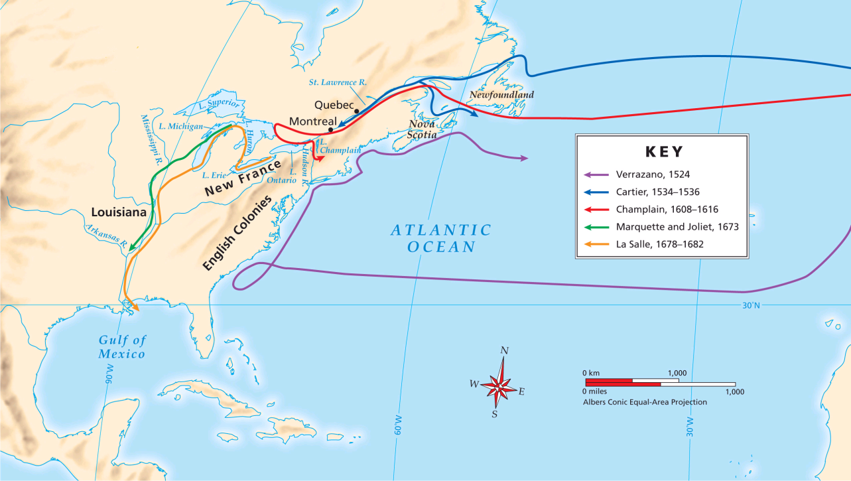
Champlain gave the French an influence in the region that lasted 150 years, and other explorers followed his lead.
By 1670, French missionary Jacques Marquette had founded two missions along the Great Lakes, in present-day Michigan.

Slide 10
In 1673, Father Marquette and French Canadian trader Louis Joliet explored Lake Michigan and the Mississippi River.
They had thought the Mississippi River might be the long-sought northwest passage, but they soon changed their minds.
However, the two did discover a water route into the heart of North America.

Slide 11
The exploration of the Mississippi was completed in 1682 by René Robert Cavelier (La Salle).
He reached the river’s mouth at the Gulf of Mexico, claimed the entire Mississippi Valley for France, and named the region Louisiana.

Slide 12
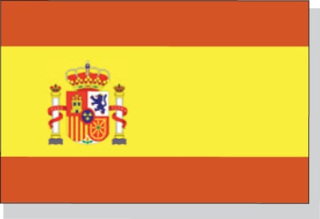
The colony of New France developed quite differently than did New Spain.
The Spanish, who wanted gold and silver, forced Native Americans into harsh labor.
The French, who wanted fish and furs, traded with Native Americans for the animal skins they sold in Europe.

Slide 13
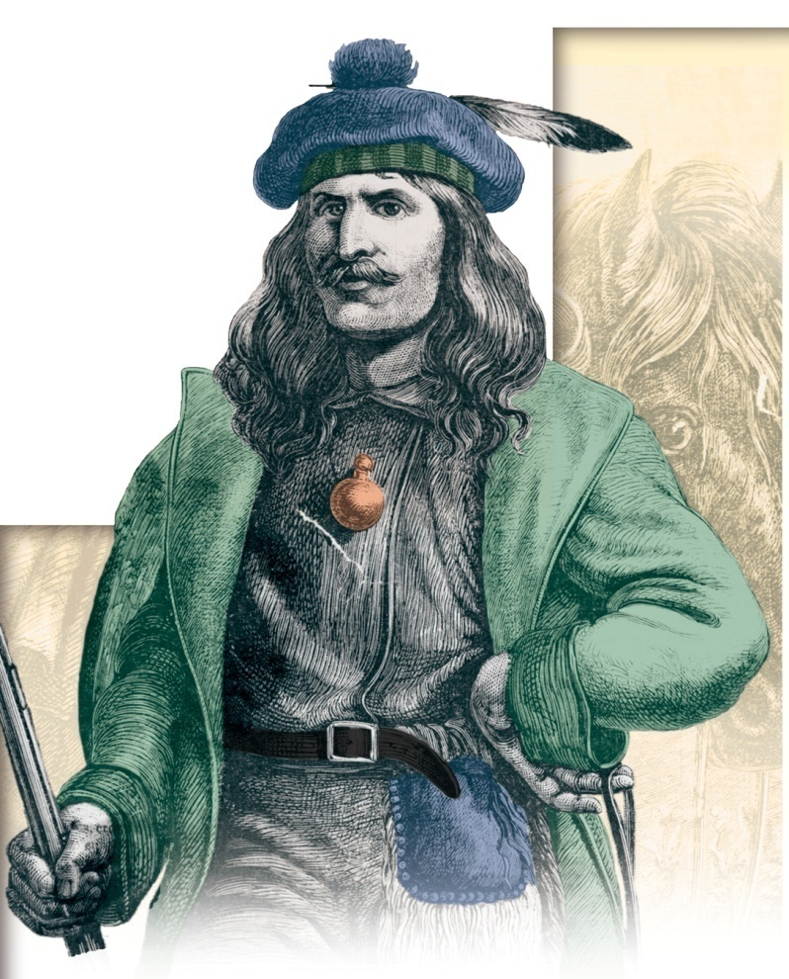
Champlain convinced Native Americans to bring pelts to French trading posts.
Trading posts such as Quebec City and Montreal became busy centers of commerce.
Coureurs de bois acquired pelts from Native Americans, and many of them married Native American women and started families.

Slide 14
Native Americans traded fur pelts to the French and Dutch in exchange for goods such as cloth, iron pots and tools, and guns.
Ultimately, however, the fur trade had grave effects on Native Americans.
lost food and land
disease
war

Slide 15
Native Americans were weakened by diseases they caught from the Europeans.
Sickness spread quickly because Native Americans had no immunity to European diseases.

Slide 16
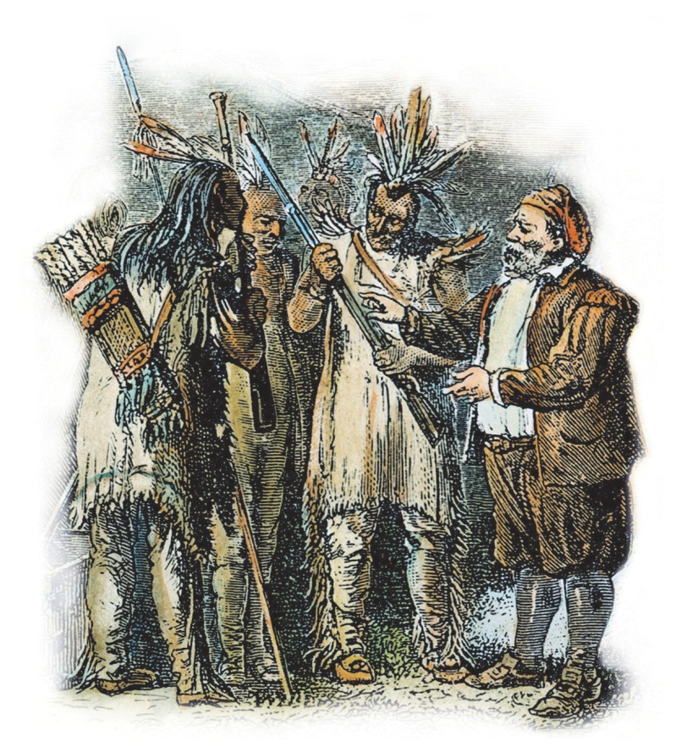
Also, the French and Dutch made alliances with different tribes, who were enemies.
The French were allied with the Hurons, and the Dutch were allied with the Iroquois.
The Iroquois attacked the Hurons with guns they got from the Dutch.

Slide 17
In addition, the fur trade caused over-trapping of animals and weakened the food chain on which Native Americans depended.
As the fur-bearing animals disappeared, the Native Americans became less valuable trading partners to the colonists.
Colonists began to covet Native American land instead.

Slide 18
In the late 1600s, French colonists began to farm in large numbers because:
Indian wars disrupted the fur trade.
The king sent 3,000 French settlers to New France.
The market for furs in Europe was in decline.
The new settlers included young single women.
New France had 5,000 colonists by 1672.

Slide 19
New Netherland kept English settlers from moving westward.
New Netherland
English settlers
New York
So in 1664, English forces seized New Netherland and renamed it New York.

Slide 20
Section Review
QuickTake Quiz
Know It, Show It Quiz
Notes:
20

Slide 21
http://www.biography.com/people/samuel-de-champlain-9243971
http://app.discoveryeducation.com/search?Ntt=French+exploration

Slide 22
Complete the following
One important thing French exploration is__________, but the most important thing about French exploration is__________.

Slide 23
Acrostic
N-E-W F-R-A-N-C-E.
Words, phrases and/or sentences must be relevant to the reasons for French exploration.

